Slide 1
1. Introduce the three papers one by one (One main paper for 15 mins, the others 5mins, total 20mins)
一一報告三篇論文的背景、文獻、研究方法與結果
2. Define the Common Research Background (3 mins)
找出三篇論文共同的研究背景或關係
3. Find the Research GAP in this domain and futher Identify the Potential Research Questions (3 mins)
從這三篇論文中，找出來這個領域在意的研究利基或研究缺口，並且找到可以做的研究問題
4. Personal Refection and future research plan after this paper review (1mins per person)
每位組員提出反思與心得以及未來研究方向

Slide 2
Midterm Report
Paper Collection Report
Group 3
施盈琪Ella, 林碩約Johnny, 胡禎Hailey, 林天牧Temple

Slide 3
Proposing a task-oriented chatbot system for EFL learners speaking practice
Hsu, M. H., Chen, P. S., & Yu, C. S. (2023). Proposing a task-oriented chatbot system for EFL learners speaking practice. Interactive Learning Environments, 31(7), 4297-4308.
https://doi.org/10.1080/10494820.2021.1960864
Informal learning
Mobile learning
Improving classroom teaching
Human-computer interface
Distance education and online learning

Slide 4
ABSTRACT
Background
Many learners of English as a foreign language struggle with spoken English, especially in conversations with native speakers, due to fears of grammatical mistakes and unfamiliarity with spoken forms. Unlike reading, spoken language requires immediate comprehension for effective communication.
Purpose
The purpose of this study is to propose an interactive chatbot system named TPBOT which stands for “TOEIC Practice Chatbot” for EFL learners to eliminate their fear of speaking English and enable them to chat with online chatbots to practice spoken English at any time.
How to help non-native English speakers improve and eliminate their anxiety when talking to English-speaking foreigners?
How to help college students improve their spoken English ability and benefit their future employment?
How to use the AI chatbot, called TPBOT, proposed in this study to help learners achieve these goals by using it for self-learning, eliminating foreign language phobia, and improving TOEIC speaking scores?

Slide 5
ABSTRACT
Method
100 Participants in this study are Taiwanese students and divided into EG and CG group.
They hope to improve their oral English ability after participating in the four-month experiment.
Result
RQ1 - Results showed that TPBOT effectively reduced students' anxiety, providing a safe, interactive environment that encouraged them to practice speaking English without fear.
RQ2 - Students in the EG who used TPBOT demonstrated significant improvements in their TOEIC speaking scores, suggesting potential advantages for future employment.
RQ3 - TPBOT proved to be a valuable self-learning resource. By offering continuous, interactive practice with immediate feedback, it helped students improve both their TOEIC scores and overall spoken English skills.

Slide 6
Introduction
Learning English is usually divided into four parts: listening, speaking, reading, and writing.
In general, Taiwanese students commonly feel shy and anxious when they are asked to speak English in class.
This is the so-called foreign language phobia, which is the feeling of panic, worry, tension, and anxiety experienced when using a second or foreign language.
Young (1990) pointed out that speaking a foreign language is not the only source of student anxiety, but speaking a foreign language in front of the class. And tried to change the classroom environment to eliminate students’ anxiety.
Additionally, Minghe and Yuan (2013) also pointed out that the factor that causes anxiety is speaking in front of others.

Slide 7
Introduction
Fortunately, EFL learners can use computer-assisted methods to reduce oral anxiety (Tallon, 2009).
Now that smartphones are easy to carry around and can easily be used to customize courses for learners, mobile learning has become a common phenomenon.
Therefore, learners can learn anytime and anywhere, and gaining knowledge is becoming increasingly convenient.
In addition, Miangah and Nezarat(2012) stated that the oral function of mobile learning is very important.Therefore, if mobile learning can cover the function of interactive oral practice, this would be of great help to language learners.
For these reasons, the AI chatbot designed in this study aims to be an effective learning tool for students to alleviate their anxiety about speaking foreign languages.

Slide 8
Introduction
There are many successful computer applications for training on speaking languages.
The development of chatbots has been undertaken to leverage learning and teaching in different disciplines.
Freudbot was developed to understand the psychology of student interaction in distance education (Heller et al., 2005). The results indicated that a basic analysis of chat records shows a high proportion of task execution.
The results also showed that chatbot technology is expected to become a teaching and learning tool in distance learning and online education (Heller et al., 2005).
In science lectures, the use of chatbots was also compared with humanoid robots, and it was reported that visualization using chatbots helps students to understand lectures smoothly (Matsuura & Ishimura, 2017).

Slide 9
Introduction
However, research on the use and development of chatbots to enhance language learning is quite difficult.
Project LISTEN's virtual reading instructor (Mostow et al., 2013) uses speech recognition to monitor children's speech when reading aloud, thereby supporting elementary school students in improving their reading skills in their first language, English.
Systems such as Robo-Sensei (Nagata, 2009) have implemented natural language processing algorithms to provide adult learners with semantic and syntactic feedback and improve foreign language grammar skills.
Physical robots have also been shown to be effective in helping children to learn aryl compound vocabulary (Vogt et al., 2019).
Hsu (2008a) proposed that robots can help young children to understand and create stories.

Slide 10
Introduction
Without a doubt, the development of educational technology has combined innovative teaching methods and new technologies to enhance the learning experience of students.
Virtual assistant or chatbot technology simplifies and enhances the learning process of students by integrating teaching methods and innovative technologies.

Slide 11
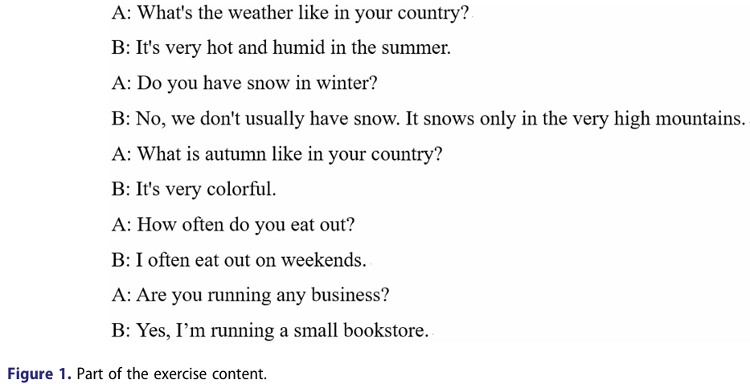
Method - Study design
This study used the experimental method to determine whether the use of TPBOT can improve students’ TOEIC speaking scores.
Both groups of students took part in two TOEIC speaking simulation pretests and posttests.
After taking the pretest, students in EG were provided with the TPBOT as a self-learning tool, and used TPBOT for a four-month oral training experiment, at least one hour a week, with part of the exercise content.
The CG did not use any experimental operations, allowing for comparison of the differences between the two groups and their results.

Slide 12
Method - Participants
The participants were 100 students from a university in northern Taiwan. The results of the TOEIC speaking simulation test showed that 48 students scored less than 100 out of 200 points.
A simple random sampling (SRS) method was used to divide the EG and CG.
24 students were assigned to the EG, and the remaining 24 were assigned to the CG.
The EG used TPBOT for speaking practice.
The CG did not use TPBOT and instead practiced with TOEIC textbooks and audio materials.

Slide 13
Method - Study instruments
The TPBOT is an online chat robot system, designed as a task-oriented chatbot with the goal of helping students improve their TOEIC speaking ability.
TPBOT has an automatic correction system that allows users to practice pronunciation by imitating the robot.
TPBOT detects students' pronunciation in real-time and provides appropriate responses.
During the TOEIC test, students must answer questions continuously, regardless of mistakes on previous questions.
TPBOT is preset with a 70% error tolerance; if a student's answer error is below 30%, they can proceed with the session, otherwise TPBOT records it as incorrect and displays the correct answer for further practice.
After each exercise, users can review their results and see the correct answers for each question.

Slide 14
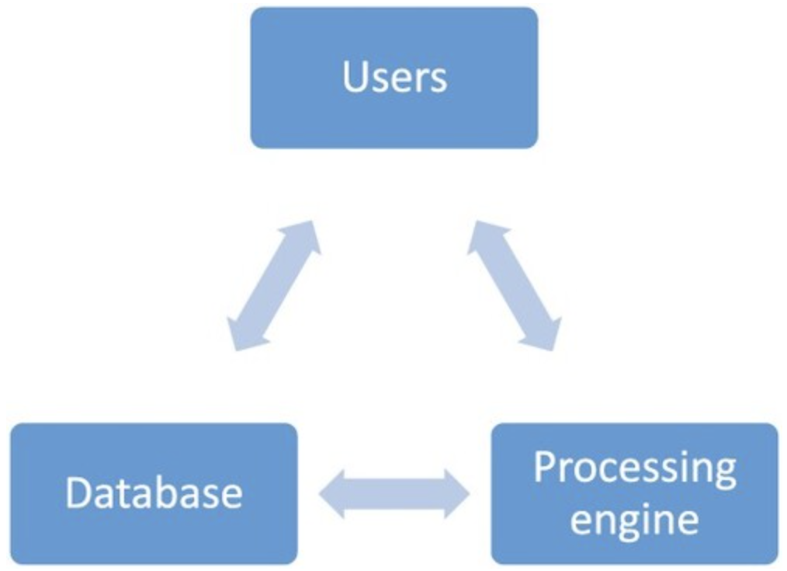
Method - The online chatbot system TPBOT
The TPBOT system on the server side comprises two major modules: the database and the processing engine.
The simplified architecture of the TPBOT system.
On the server side, the system requires Python version 3.7, Ngrok, and a LINE Developers account.
Additional packages used include line-bot-sdk version 1.8.0, pydub version 0.23.1, and speech_recognition version 3.8.1.
The pydub package quickly converts files into the required format.
The speech_recognition package allows TPBOT to recognize all languages through Google.

Slide 15
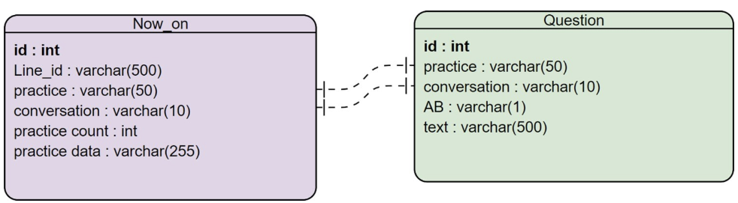
Method - The online chatbot system TPBOT(The database)
All conversations are stored in the relational database named PostgreSQL, which is an relational database.
The data sheet “Now_on” records:
The user’s basic information.
The user’s current practice progress for each exercise.
The date and frequency of each exercise.
The field “practice” records the user’s current practice.
The field “conversation” records the user’s current dialogue practice.
The field “practice data” records the user’s feedback on the exercise.
The data sheet “Questions” is used to store exercise questions:
It contains all exercise questions for the system to retrieve and compare with user responses.
The field “practice” records the practice code of each question.
The field “conversation” records the conversation code of each question.
The field “text” records the content of each question.
The “AB” field is a flag that determines whether the user or the system is speaking.

Slide 16
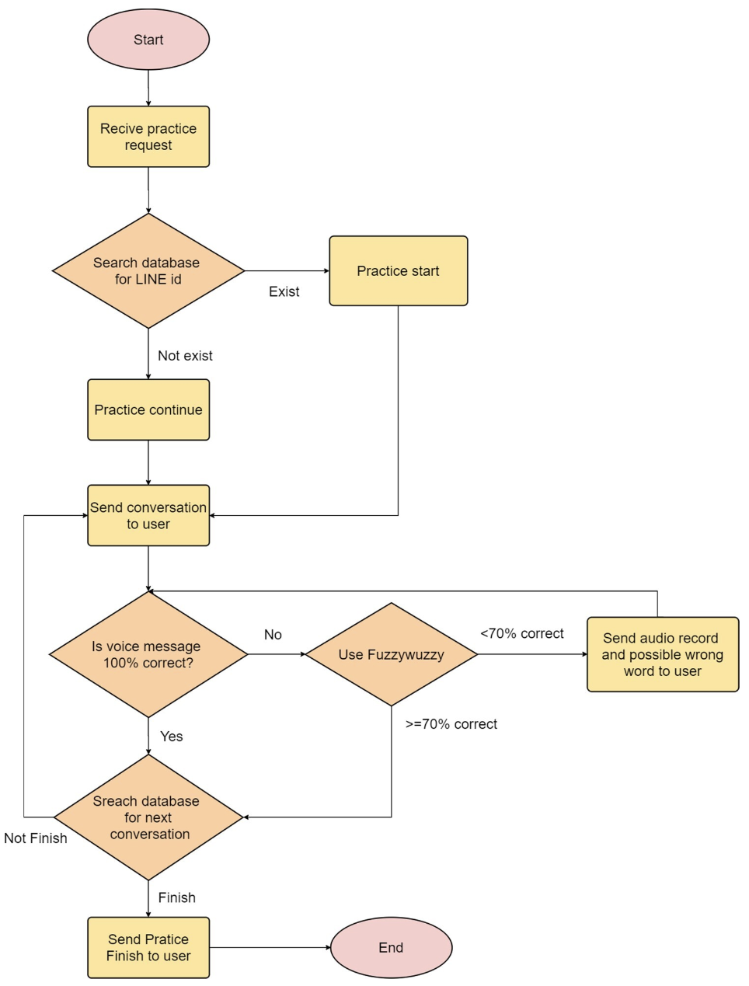
Method - The online chatbot system TPBOT(Processing engine)
If a user sends a voice message, the system will perform the following steps:
When the user logs in to TPBOT, a practice menu appears, allowing them to select exercise types (listening, speaking, reading).
The converted voice message is processed with the Speech_recognition package and sent to Google for voice recognition.
The system retrieves the exercise data and conversation code from the database and temporarily stores the conversation text.
The recognized text from Google is compared with the stored conversation text.
If there’s no exact match, the fuzzywuzzy package checks the similarity between the user’s response and the expected sentence, using Levenshtein's method to calculate differences.
If the system cannot interpret the user’s answer (e.g., due to silence, noise, or connection issues), it displays a message asking the user to repeat, saying, "Sorry, I didn’t quite catch that.”
If the server disconnects during an exercise, it records the user’s last position. The user can resume or start a new exercise when they log back in.
Notes:
If a user sends a voice message, the system will perform the following steps:
When the user logs in to TPBOT, a practice menu appears, allowing them to select exercise types (listening, speaking, reading).
Upon receiving an exercise request, the system checks if the user is new or returning. For new users, their data is stored, and they are directed to the first exercise dialogue.
When the user sends back a voice message, the system converts it from .m4a to .wav format using the pydub package and FFmpeg software.
The converted voice message is processed with the Speech_recognition package and sent to Google for voice recognition.
The system retrieves the exercise data and conversation code from the database and temporarily stores the conversation text.
The recognized text from Google is compared with the stored conversation text.
If there’s no exact match, the fuzzywuzzy package checks the similarity between the user’s response and the expected sentence, using Levenshtein's method to calculate differences.
If the response is acceptable, the system converts a reply to the user into a voice message using Google text-to-speech and prompts the next guided sentence. If the user’s pronunciation is too far off, the system provides the correct pronunciation and highlights key words needing improvement.
If the system cannot interpret the user’s answer (e.g., due to silence, noise, or connection issues), it displays a message asking the user to repeat, saying, "Sorry, I didn’t quite catch that.”
If the server disconnects during an exercise, it records the user’s last position. The user can resume or start a new exercise when they log back in.

Slide 17
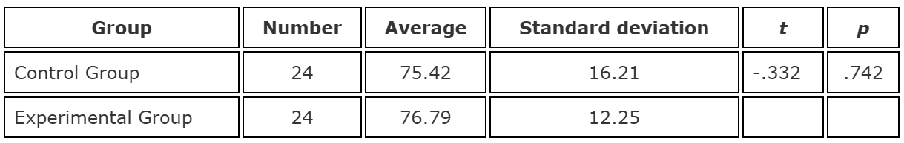
Pre-experimental statistical analysis
TOEIC speaking simulated test as a basis for comparison.
An independent-sample t-test was used to compare the difference in means between the CG and the EG.
The CG included 24 individuals with an average test score of 75.42, while EG with 76.79 in an average test score.
In Table 2, the test statistic t = -0.332, p = 0.742, didn’t significance.
The analysis results indicated no significant difference between the CG and the EG.
Table 2

Slide 18
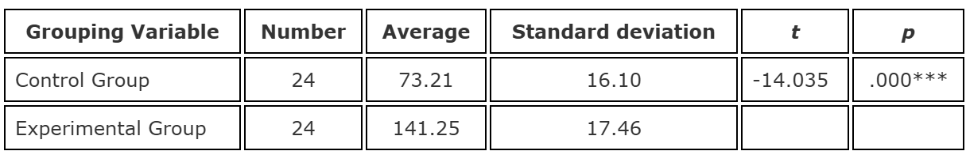
Post-experimental statistical analysis
Four months later, the 48 students took the TOEIC speaking simulation posttest.
The CG included 24 individuals with an average posttest score of 73.21, while EG with 141.25 in an average posttest score.
In Table 4, the test statistic t = -14.035, p = 0.000. The null hypothesis is rejected.
The analysis results indicate a significant difference between the means of the CG and EG.
The test results showed that students in the EG made significant progress, while students in the CG did not.

Slide 19
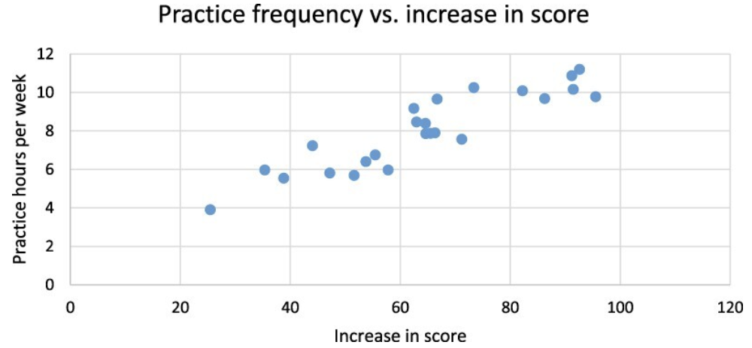
Result
The students who used TPBOT made significant improvements in their oral English ability, while the students who did not use TPBOT had limited or no progress.
In EG, result indicating variation in improvement among students.
The most students found learning spoken English with an interactive chatbot to be interesting and convenient on a smartphone.
Students with lower practice frequency had slower learning progress.
In the CG, the average score dropped by 2 points indicating little progress.
The study's results, along with Ruan et al. (2019), confirm that chatbots play an important role in user learning.
Most students found TPBOT helpful and noted an improvement in their TOEIC learning performance.

Slide 20
Disscusion
Results indicate that TPBOT is an effective self-learning tool, fulfilling the research questions and reducing learners’ anxiety about speaking English with foreigners.
This outcome aligns with Bashori et al. (2020), who found similar benefits in web-based language learning for reducing speaking anxiety.
Minghe and Yuan (2013) emphasized the importance of out-of-class learning and practice for improving oral proficiency, sustaining motivation, and reducing anxiety, which the TPBOT also supports.
Analysis results showed a significant difference between the CG and EG means, with the EG showing a higher mean.
Test results demonstrated significant progress in the EG, while the CG didn’t.
After observing the progress in the EG, CG students expressed increased motivation and a desire to use TPBOT for oral practice.

Slide 21
Conclusion and future research
Through interacting with TPBOT, learners received immediate corrective feedback, enabling comprehensive spoken language drills (Ruan et al., 2019).
TPBOT helped reduce learners’ anxiety when speaking a foreign language to native speakers, aligning with similar findings in Bashori et al. (2020).
Various considerations were incorporated into the study design to avoid research errors.
A limitation of the study was controlling the frequency and duration of TPBOT usage among students.
This study demonstrates that TPBOT can support self-learning in other spoken languages.
Future research could integrate TPBOT with Hsu's recommendation system, an assisted language learning system for EFL learners (Hsu, 2008a; Hsu, 2008b), to enhance language learning assistance.

Slide 22
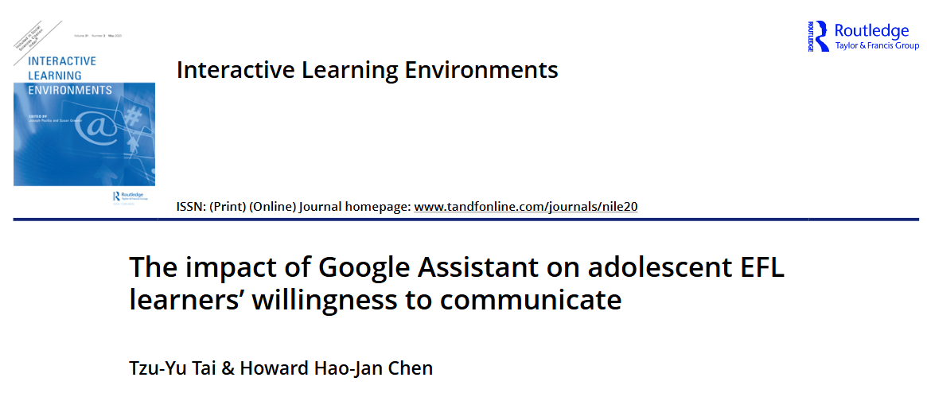
Related Study1: The impact of Google Assistant on adolescent EFL learners' willingness to communicate
Tai, T. Y., & Chen, H. H. J. (2020). The impact of Google Assistant on adolescent EFL learners’ willingness to communicate. Interactive Learning Environments, 31(3), 1485–1502. https://doi.org/10.1080/10494820.2020.1841801
Notes:
次要1：The impact of Google Assistant on adolescent EFL learners' willingness to communicate

Slide 23
Abstract
Background
Willingness to communicate (WTC) is crucial for successful language learning, and while AI-powered IPAs show potential to enhance WTC, few empirical studies have explored their impact.
Purpose
This research discusses the impact of Google Assistant on improving WTC among Taiwanese adolescent EFL learners.
Results
Google Assistant significantly improved students' communicative confidence, reduced speaking anxiety, and increased their willingness to use English.
Students reported the interaction process with Google Assistant made them feel relaxed, and improved their motivation and confidence.

Slide 24
Research Background
IPAs and L2 education
IPAs offer personalized, stress-free learning opportunities through real-time interaction and ASR technology (Moussalli & Cardoso, 2019; Kessler, 2018).
WTC in L2 learning
Higher WTC is essential for language acquisition, as it promotes authentic communication and reduces learner anxiety. (MacIntyre, 2017; Mystkowska-Wiertelak & Pawlak, 2016)
Research Questions
Does Google Assistant significantly promote adolescent EFL learners' WTC in English? If so, what factors contribute to learners' WTC?
What are adolescent EFL learners’ favorite Google Assistant language learning activities that enhance WTC?
What are the adolescent EFL learners’ perceptions of Google Assistant for English learning?
Notes:
IPA => Intelligent Personal Assistants
ASR => Automatic Speech Recognition
L2 => Second Language
IPA => offer stress-free environment => improve WTC => improve L2 learning.
Does Google Assistant significantly promote the adolescent EFL learners’ WTC in English? If so, what factors contribute to learners’ WTC?
What are adolescent EFL learners’ favorite Google Assistant language learning activities that enhance WTC?
What are the adolescent EFL learners’ perceptions of Google Assistant for English learning?

Slide 25
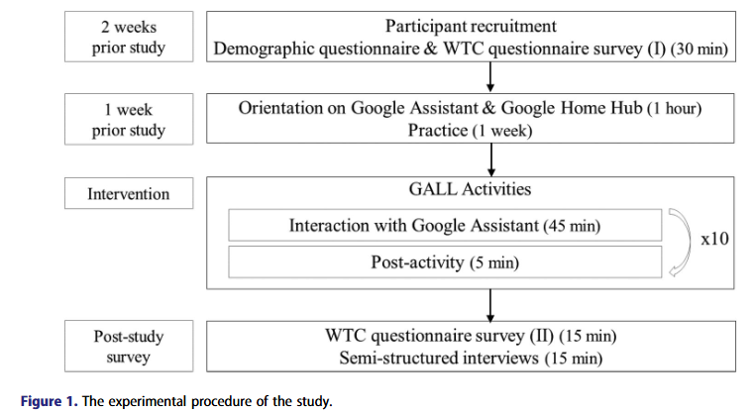
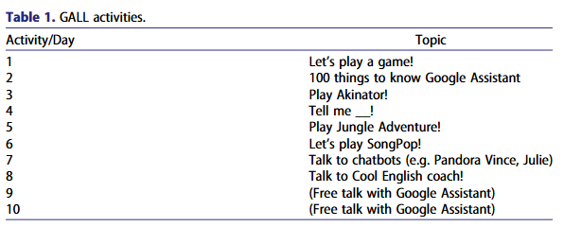
Method
Participants
112 eighth-grade students who with elementary to intermediate English proficiency levels.
Google assistant language learning (GALL) activities
8 activities provided interactive, self-paced oral English practice, incorporating group, paired, and individual tasks.
Instruments
Learning devices: Google Home Hub, Google Assistant.
Data collection: Background questionnaires, WTC in English questionnaire (MacIntyre et al.’s, 2001; Carrell & Menzel’s, 1999; Reinders & Wattana’s, 2014; Lee & Drajati’s, 2019), Interviews.
Data Analysis: Paired-samples t-test
Notes:
Background questionnaires => include six items to gather demographic data and other information concerning the participants’ previous language learning experience and exposure to the technology such as IPAs
WTC in English questionnaires => were adapted from
interview => two questions are: (1) What is your favorite GALL activity(ies) that promote WTC? (2) How do you feel about Google Assistant for English learning?
The reliability of WTC questionnaire was considered to be good (α = .85)

Slide 26
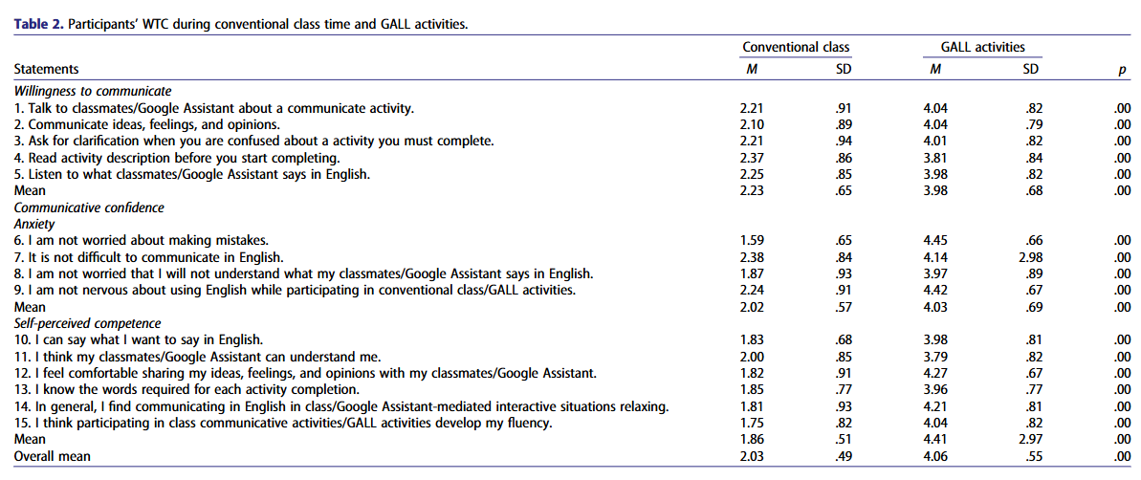
Results
RQ1: Does Google Assistant significantly promote EFL learners' WTC in English?
The participants have higher WTC in English with Google Assistant environment than in a conventional class.

Slide 27
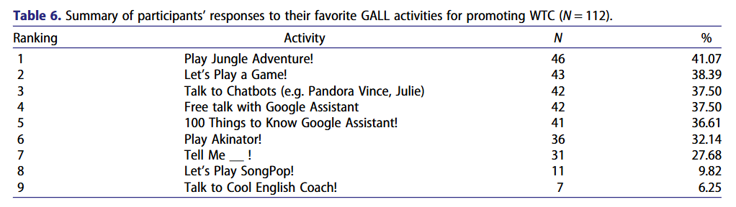
Results
RQ2: What are learners’ favorite GALL activities that enhance WTC?
The participants enjoyed playing games with Google Assistant, especially those involving interesting and interactive elements.
In addition, they don’t like the activities which were similar to their regular classroom exercises in English class.

Slide 28
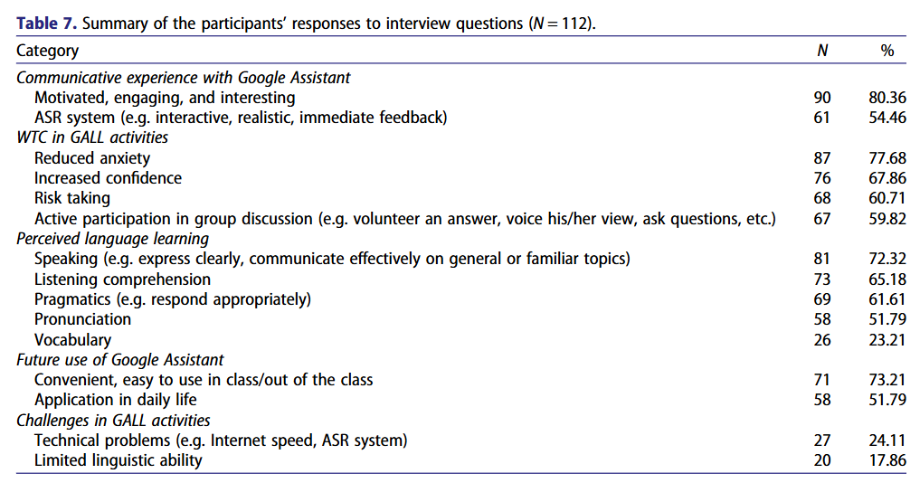
Results
RQ3: What are the EFL learners’ views of Google Assistant for English learning?
The majority of them have enjoyable interaction. It lowered the anxiety, bolstered their confidence and improve the motivation.

Slide 29
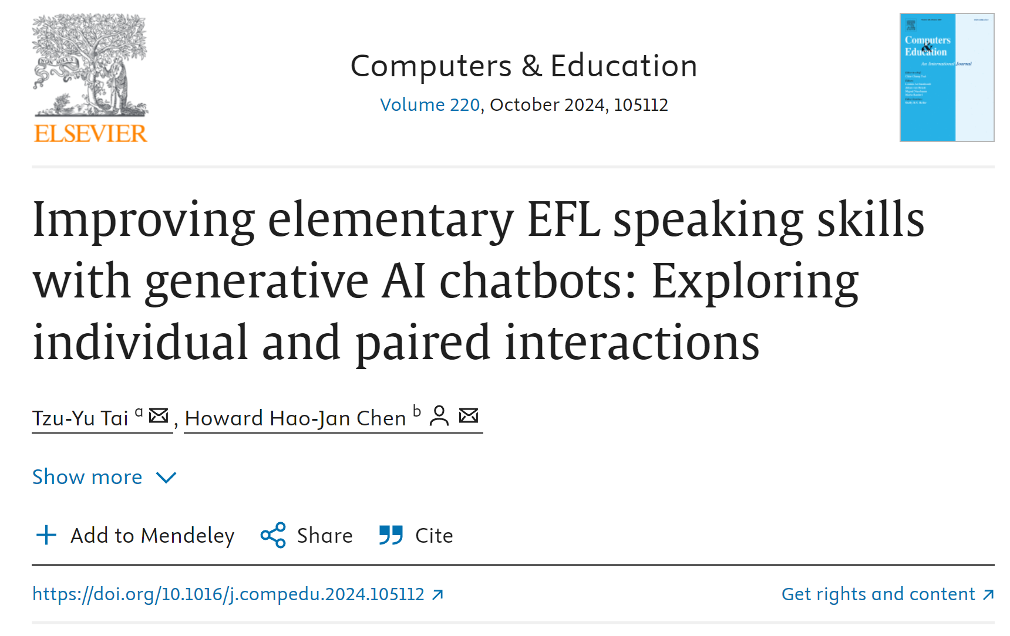
Related Study2: Improving elementary EFL speaking skills with generative AI chatbots: Exploring individual and paired interactions
Tai, T. Y., & Chen, H. H. J. (2024). Improving elementary EFL speaking skills with generative AI chatbots: Exploring individual and paired interactions. Computers & Education, 220, 105112.
Notes:
次要1：The impact of Google Assistant on adolescent EFL learners' willingness to communicate

Slide 30
Abstract
This study examines the effects of generative AI (GAI) chatbots on English as a Foreign Language (EFL) speaking skills in elementary students, with a focus on individual vs. paired interaction settings.
Participants & Methodology
Participants: 85 sixth-grade Taiwanese students in a summer English-speaking program.
Groups: Three groups were used:
Individual Chatbot Interaction
Paired Chatbot Interaction
Traditional Classroom Learning
Students used "CoolE Bot," a GAI-based chatbot, to practice English-speaking skills daily.
Key Findings
Both individual and paired chatbot groups demonstrated significantly improved speaking skills compared to the traditional classroom group.
No major differences in improvement were noted between the individual and paired chatbot interactions.
Students found CoolE Bot engaging, reporting reduced language anxiety, increased confidence, and an enjoyable learning experience.

Slide 31
Introduction
Speaking skills are essential for language proficiency, and AI chatbots have emerged as effective tools in language learning by offering authentic, adaptive conversational practice. Recent advancements in generative AI (GAI) and automatic speech recognition (ASR) have further enhanced chatbots’ ability to deliver coherent, contextually relevant responses, especially for young learners.
This study examines the impact of a GAI-based chatbot, "CoolE Bot," on elementary EFL speaking skills through individual and paired interactions. CoolE Bot leverages advanced AI and ASR to create engaging, realistic conversations tailored to young learners' developmental needs. This research aims to deepen understanding of GAI chatbots in elementary language education, offering insights for future application.

Slide 32
Method
Design This study assessed the impact of a GAI chatbot, CoolE Bot, on EFL speaking skills in elementary students. Eighty-five sixth-graders from Taiwan were divided into three groups:
I-Bot Group: Individual interactions with CoolE Bot.
P-Bot Group: Paired interactions with CoolE Bot.
No-Bot Group: Traditional classroom interactions with teachers and peers.
Students engaged in 45-minute daily sessions over three weeks, and a corresponding written worksheet that offered essential information and prompts for completing the tasks.
Instruments
CoolE Bot: A GAI-powered chatbot incorporating ChatGPT, TTS, and ASR, designed for personalized and immersive English learning.
English-Speaking Tests: Adapted from the General English Proficiency Test (GEPT) Kids, assessing fluency, content, pronunciation, grammar, and vocabulary.
Semi-Structured Interviews: Post-study interviews in Chinese gathered qualitative feedback on learners' perceptions of CoolE Bot.

Slide 33
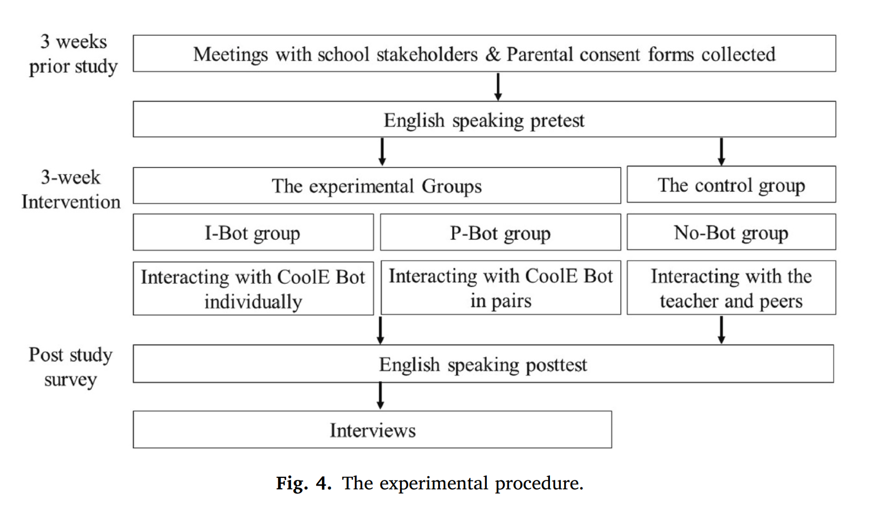
Method - 2
Procedure
After obtaining consent and providing orientations, students engaged in daily tasks with CoolE Bot on topics like hobbies and pets. Bot groups completed chatbot interactions, while the No-Bot group participated in teacher-guided tasks. Pre- and post-tests measured speaking improvements, and interviews provided additional insights.

Slide 34
Results of Speaking Tests
The two-way mixed-design ANOVA demonstrated that CoolE Bot significantly improved EFL speaking skills in both individual (I-Bot) and paired (P-Bot) settings, with these main effects:
Groups: F(2, 82) = 6.06, p < 0.001, ƞ² = 0.13
Time: F(1, 82) = 275.00, p < 0.001, ƞ² = 0.77
Group × Time Interaction: F(2, 82) = 7.31, p < 0.001, ƞ² = 0.15
Pretest scores showed no significant difference across groups (F(2, 164) = 2.19, p = 0.12, ƞ² = 0.05), but post-test scores revealed a significant improvement in the I-Bot and P-Bot groups over the No-Bot group (F(2, 164) = 10.24, p < 0.001, ƞ² = 0.20), with no significant difference between the Bot groups.
Notes:
"Peer dynamics" refers to the interactions and social behaviors that occur between students when they work together, in this case, in paired sessions with CoolE Bot. These dynamics include how well they collaborate, support each other, and share speaking opportunities, as well as any conflicts or issues that arise.
In the study, some participants faced challenges related to peer dynamics, such as disagreements on who should speak first, conflicting interests in conversation topics, or even reverting to their native language (Chinese) instead of practicing English. These issues affected the smoothness and effectiveness of their paired interactions, highlighting that while collaborative settings can provide benefits, they also introduce complexities that can impact the learning experience.

Slide 35
Qualitative Findings from Interviews
Five themes emerged from interviews, reflecting positive and challenging aspects of using CoolE Bot:
Coherent Interaction: Most participants felt CoolE Bot’s responses were engaging and contextually appropriate, with I-Bot (89.28%) and P-Bot (82.14%) participants reporting improved speaking skills.
Conversational Style: Participants enjoyed CoolE Bot’s conversational charisma and human-like voice (I-Bot: 78.57%; P-Bot: 78.57%), making interactions more enjoyable.
Diverse Topics: Over half the participants (I-Bot: 60.71%; P-Bot: 67.86%) appreciated CoolE Bot's range of topics, which helped sustain interest and exploration.
Supportive Environment: Many participants felt CoolE Bot provided emotional support and encouragement, with I-Bot (75%) and P-Bot (64.29%) noting reduced anxiety during interactions.
Challenges: Some students struggled with language complexity (I-Bot: 25%; P-Bot: 17.86%) and found peer collaboration challenging in maintaining smooth interactions.
Overall, CoolE Bot effectively enhanced engagement and speaking skills in a supportive, conversational format, although challenges related to language complexity and peer dynamics were noted.
Notes:
"Peer dynamics" refers to the interactions and social behaviors that occur between students when they work together, in this case, in paired sessions with CoolE Bot. These dynamics include how well they collaborate, support each other, and share speaking opportunities, as well as any conflicts or issues that arise.
In the study, some participants faced challenges related to peer dynamics, such as disagreements on who should speak first, conflicting interests in conversation topics, or even reverting to their native language (Chinese) instead of practicing English. These issues affected the smoothness and effectiveness of their paired interactions, highlighting that while collaborative settings can provide benefits, they also introduce complexities that can impact the learning experience.

Slide 36
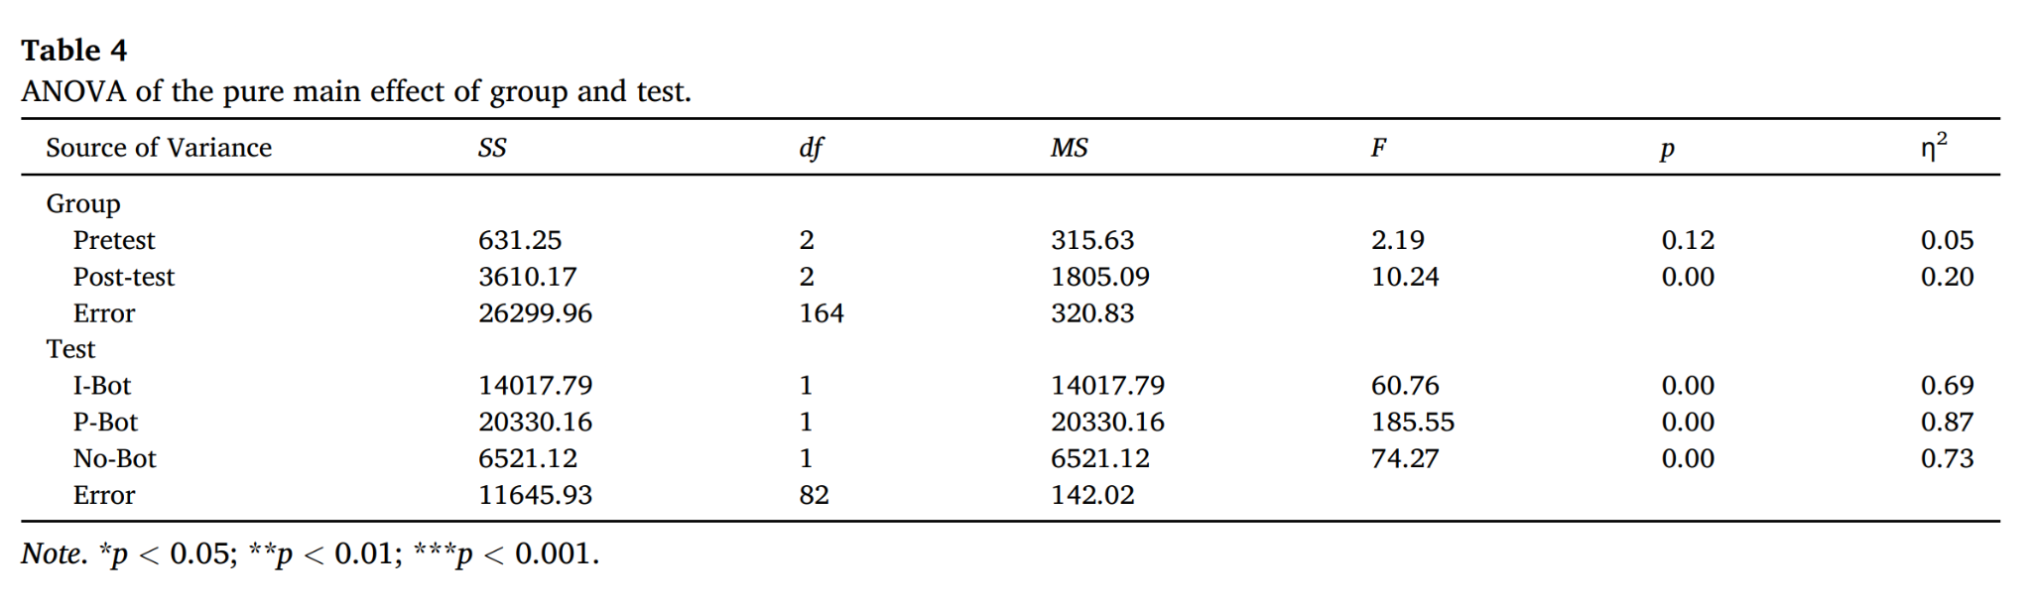

Slide 37
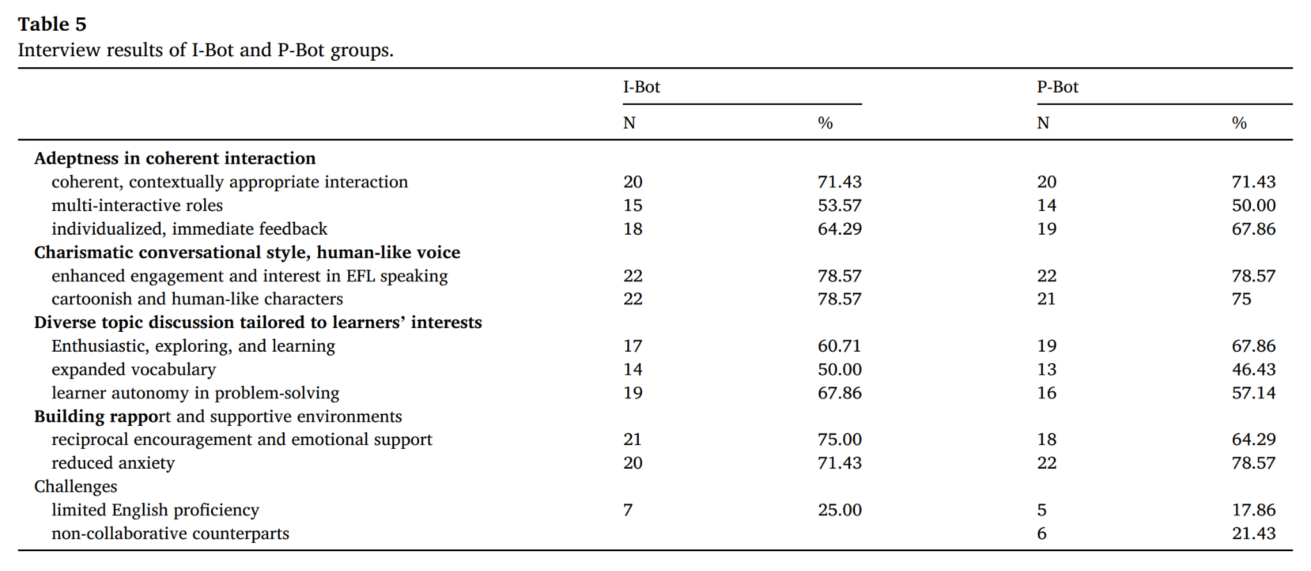

Slide 38
Conclusion
This study demonstrated that the GAI-based chatbot CoolE Bot effectively enhances elementary EFL learners' speaking skills, with significant improvements observed in both individual and paired interactions. CoolE Bot's authentic communication, immediate feedback, and engaging character designs fostered a supportive learning environment, enabling both personal and collaborative cognitive development.
Pedagogical Implications CoolE Bot proves adaptable for various educational settings, offering effective support whether used individually or with peers. For optimal learning experiences, future GAI chatbot designs should incorporate language simplification and supportive features tailored to young learners' needs.
Limitations and Future Research The study's short duration and participant demographics suggest caution in generalizing results. Future research should consider more diverse samples and factors such as student interest, proficiency, and collaboration styles. Studies exploring different GAI technologies and cultural contexts will provide further insights into the effective integration of chatbots in EFL curricula.

Slide 39
Common Research Background
Shared Focus Across Studies on AI and Chatbots in EFL Learning
AI Tools for EFL Speaking Skills
All three studies examine AI tools (TPBOT, Google Assistant, CoolE Bot) designed to support English as a Foreign Language (EFL) learners in developing speaking skills.
Emphasis on creating interactive, conversational environments for practice, like real life.
Addressing Language Learning Challenges
The studies target common issues in EFL learning: anxiety, limited speaking opportunities, and lack of real-world interaction.
AI systems provide a less intimidating, more engaging environment that reduces learners' fear of making mistakes.

Slide 40
Common Research Background
Empirical Framework
Each study employs an empirical research design with real-world participants:
TPBOT: University students engaging in TOEIC practice.
Google Assistant: Adolescent students focusing on willingness to communicate.
CoolE Bot: Elementary students practicing in both individual and paired settings.
Themes and Methods in EFL-focused AI Research
All papers highlight AI’s capacity to facilitate language learning through automatic speech recognition (ASR) and natural language processing (NLP).
Use of AI-driven feedback mechanisms to foster self-correction and language output.

Slide 41
Research Gap & Unanswered Questions
Gap 1: Limited Cross-age Comparisons in AI Effectiveness
Existing studies focus on specific age groups (university, adolescents, elementary) without comparing how age impacts AI’s effectiveness in EFL.
Potential Research Question: How does the effectiveness of AI tools in enhancing EFL speaking skills vary across different age groups?
Gap 2: Impact of Interaction Settings
Few studies explore diverse interaction settings (individual vs. collaborative/paired). The CoolE Bot study begins to address this but leaves room for further investigation.
Potential Research Question: Do individual, paired, or group interactions with AI chatbots lead to different language learning outcomes?
Gap 3: Longitudinal Effects of AI-assisted Language Practice
Most studies are short-term (2-3 weeks), lacking insights into long-term impacts on speaking proficiency and retention.
Potential Research Question: What are the long-term effects of AI chatbot interventions on EFL learners’ speaking skills and language retention?

Slide 42
Reflection & Ruture Research Plan
Johnny: The help of AI in our world will be inevitable, so think of it as a tool, not something to replace you, the more you know how to use it, the more valuable you are, further research could be on learning different languages, cause the chatbots or the LLMs may not be that good at that specific language.
Temple: GAI chatbots like CoolE Bot show great promise as supportive learning tools that complement traditional teaching. To further enhance their effectiveness, future research should focus on adapting GAI chatbots for diverse languages and age-appropriate content, ensuring they meet the specific needs of younger and non-native learners.
Hailey: Integrating AI tools into education is an inevitable trend. We should keep an open mind to explore how to use them ethically to maximize their benefits for our learning activities. Future research could explore the impact of AI tools applied to different subjects of learning, to evaluate the generalization of these tools across various fields of domain.
Ella: AI shows strong potential in English learning, especially in reducing learner anxiety and improving practice effectiveness. Tools like TPBOT provide valuable feedback and more speaking opportunities. However, future research could explore incorporating embodied agents into the learning process, thus enhancing interaction and learning experiences for students.

